Slide 1
Gerhana Penuh Bulan
Total Lunar Eclipse
April 04, 2015
Oleh Persatuan Astronomi Negara Brunei Darussalam
By The Astronomical Society of Brunei Darussalam
www.bruneiastronomy.org
pabd@bruneiastronomy.org

Slide 2
Kandungan / Contents
Fenomena Gerhana Bulan / Lunar Eclipse Phenomenon
Kenampakan Gerhana / Eclipse Visibility
Masa Rasmi Gerhana / Eclipse Official Timing
Kekerapan Gerhana Bulan / Frequency Of Lunar Eclipse
Cerapan Gerhana Penuh Bulan / Total Lunar Eclipse Observation

Slide 3
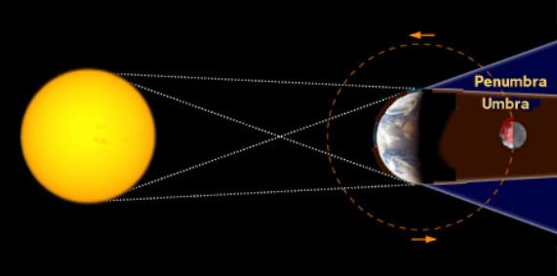
Fenomena Gerhana Bulan / Lunar Eclipse Phenomenon
starryskies.com
Gerhana bulan berlaku apabila Bulan merentasi tepat di belakang Bumi dan berada dalam bayang-bayang bumi yang gelap iaitu Umbra. Kejadian semula jadi yang jarang dan hanya berlaku apabila Matahari, Bumi dan Bulan adalah sejajar dengan bumi tepat di tengah-tengah.
A Lunar eclipse occurs when the Moon passes directly behind the Earth and being in the Earth’s dark shadow known as Umbra. Such occurrence is rare when the Sun, Earth and Moon are exactly aligned with the Earth being precisely in the middle.

Slide 4
Kenampakan Gerhana / Eclipse Global Visibility
Sumber Sky & Telescope April 2015
Boleh diamati oleh sebahagian besar kawasan dunia iaitu Asia, Australia, Pasifik, Amerika Utara dan Selatan.
Visible in many region around the globe such as Asia, Australia, Pacific, North and South America.

Slide 5
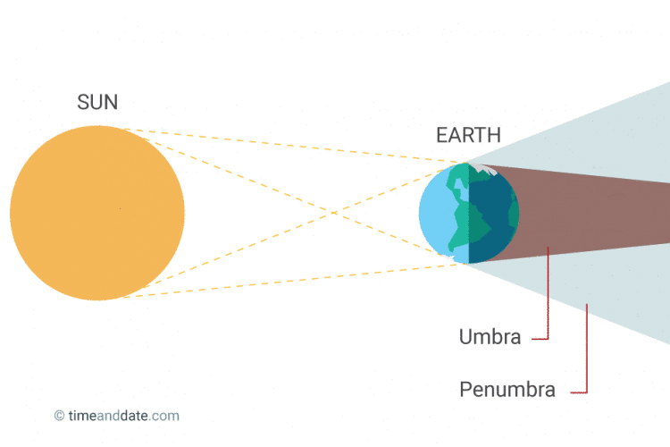
Masa Rasmi Gerhana / Eclipse Official Timing
P4
P1= 17:01:27**
U1= 18:15:45**
U2= 19:57:54
Greatest: 20:00:14
U3= 20:02:37
U4= 21:44:46
P4= 22:58:58
**Tidak kelihatan kerana bulan berada di bawah ufuk. / Not visible as the below is below the horizon
U4
U3
U2
U1
P1

Slide 6
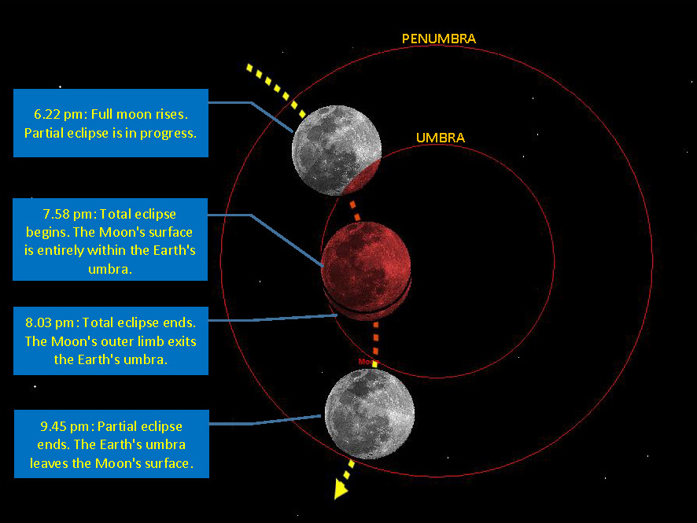
Masa Rasmi Gerhana / Eclipse Official Timing
Peringkat-peringkat gerhana dan keadaan bulan dari Brunei sewaktu merentasi bayangan bumi pada 04 April 2015. / Phases of the eclipse and local lunar circumstances as the Moon passes the Earth's shadow on April 4, 2015, from Brunei.

Slide 7
Kekerapan Gerhana Bulan di Negara Brunei / Frequency Of Lunar Eclipse in Brunei
Dari tahun 2001 hingga 2100 terdapat 61 gerhana penuh berlaku di Brunei. From 2001 until 2100 there are 61 total eclipses of the moon visible from Brunei.
Gerhana Bulan seterusnya / Next Lunar Eclipse:
  2017 Aug 08 02:20 Partial Lunar
  2018 Jan 31 21:30 Total Lunar 01h 16m 52s
  2018 Jul 28 04:21 Total Lunar 01h 43m 34s

Slide 8
Kekerapan Gerhana Bulan di Negara Brunei / Frequency Of Lunar Eclipse in Brunei
Gerhana Penuh Bulan paling pendek dalam abad ke-21 / 21st century’s briefest view of Total Lunar Eclipse.
  2015 Apr 04 20:00 Duration: 00h 04m 43s
  2021 May 26 19:18 Duration: 00h 14m 30s
  2068 Nov 09 19:44 Duration: 00h 18m 21s
  2061 Apr 05 05:52 Duration: 00h 29m 53s
  2090 Sep 09 06:49 Duration: 00h 31m 51s

Slide 9
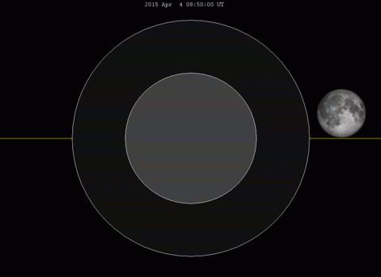
Gerhana Penuh Bulan paling pendek dalam abad ke-21 / 21st century’s briefest view of total Lunar Eclipse.
Simulasi oleh earthsky.org
Laluan bulan merentasi bayang bumi di penjuru sempadan umbra / The moon passing very close to outer rim of the Umbra.

Slide 10
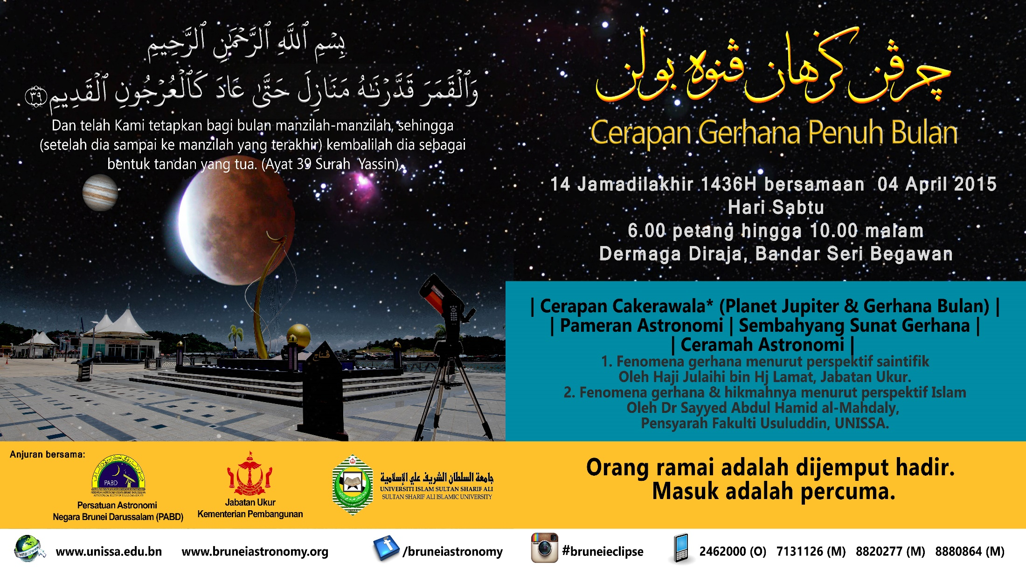
Cerapan Gerhana Penuh Bulan / Total Lunar Eclipse Observation

